Slide 1
Unit-1 Algebraic structure and Morphism Recall / Revision: Set theory and operations Set Operation

Slide 2
Revision: Algebraic structure

Slide 3
Revision: Properties/conditions

Slide 4
Revision:

Slide 5
Revision:

Slide 6
Revision:

Slide 7
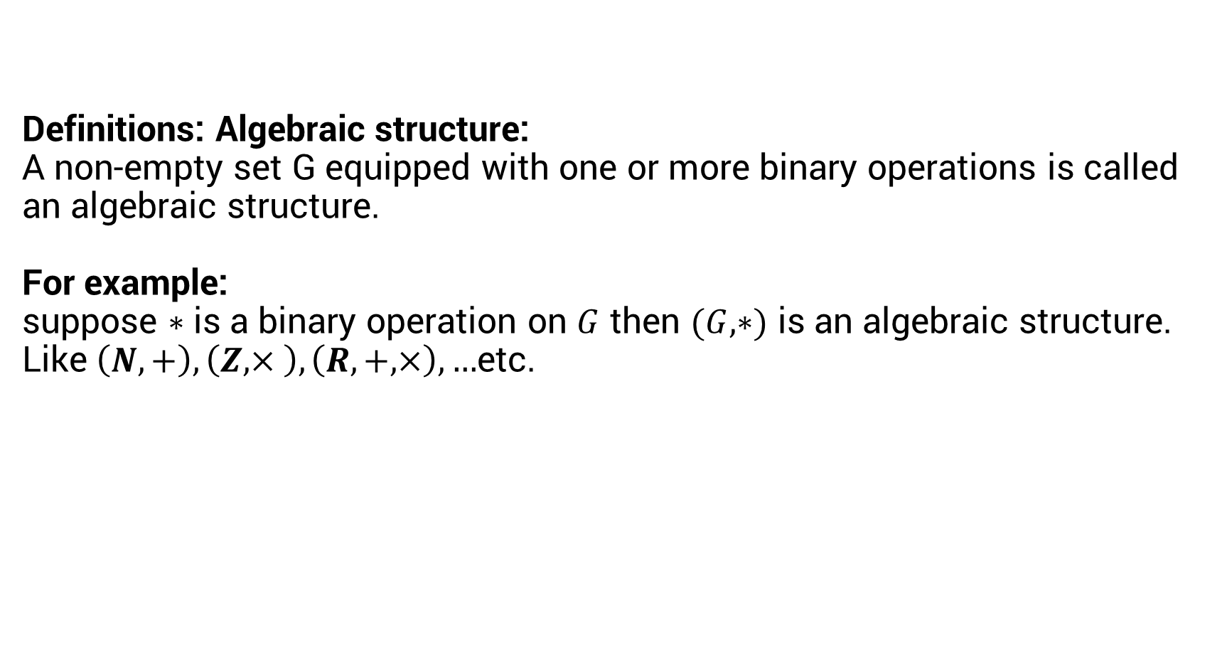
Definitions: Algebraic structure: A non-empty set G equipped with one or more binary operations is called an algebraic structure. For example: suppose $∗$ is a binary operation on $G$ then $(G,∗)$ is an algebraic structure. Like $\left(N,+\right), \left(Z,× \right), \left(R,+,×\right),…$etc.

Slide 8
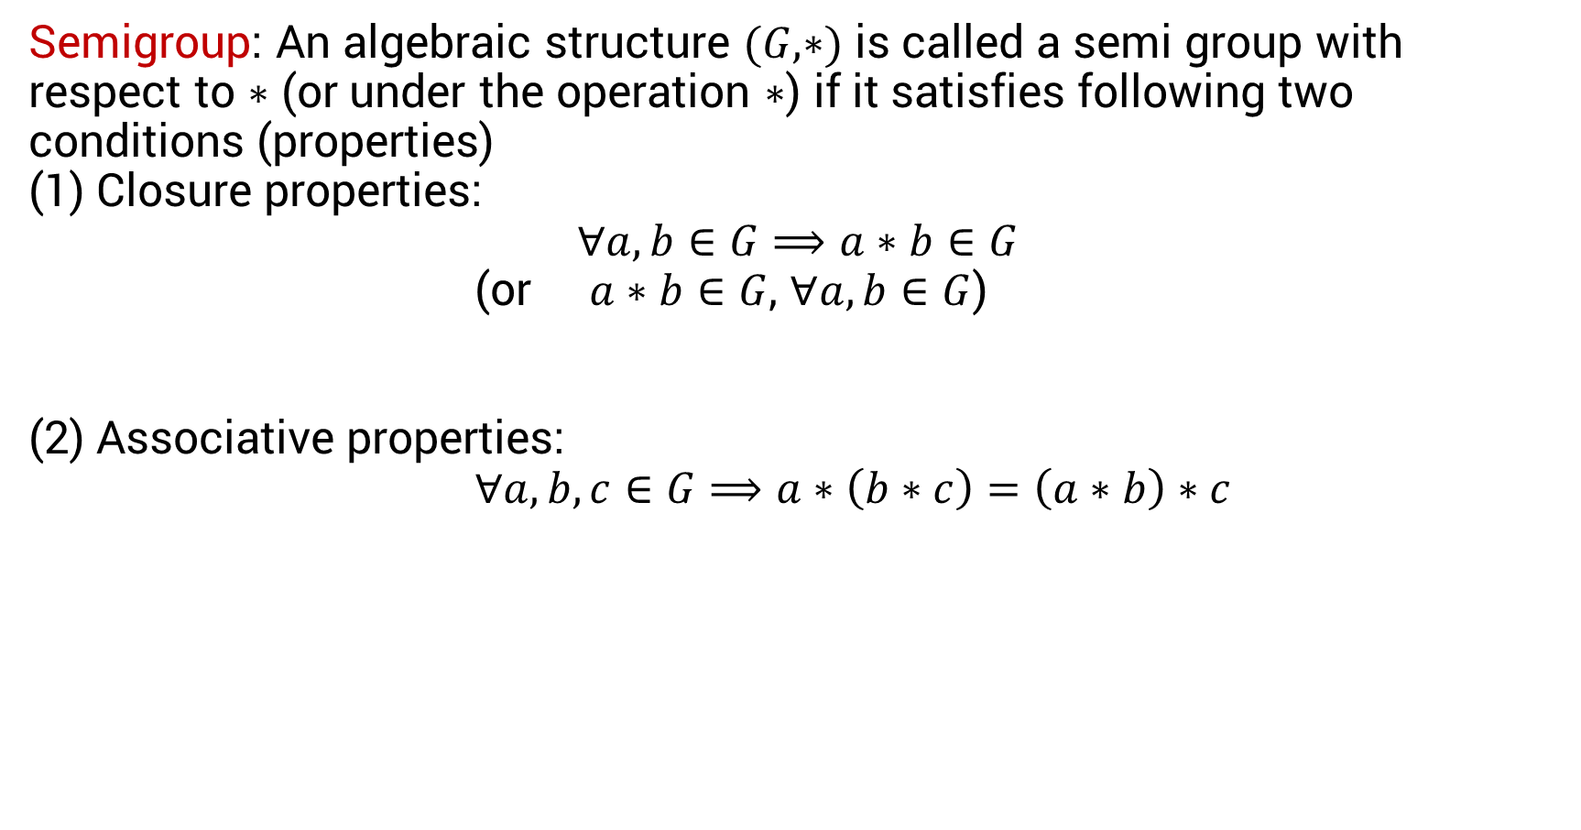
Semigroup: An algebraic structure $(G,∗)$ is called a semi group with respect to $∗$ (or under the operation $∗$) if it satisfies following two conditions (properties) (1) Closure properties: $$∀a,b∈G⟹a∗b∈G$$ (or $a∗b∈G$, $∀a,b∈G$) (2) Associative properties: $∀a,b,c∈G⟹a∗\left(b∗c\right)=\left(a∗b\right)∗c$

Slide 9
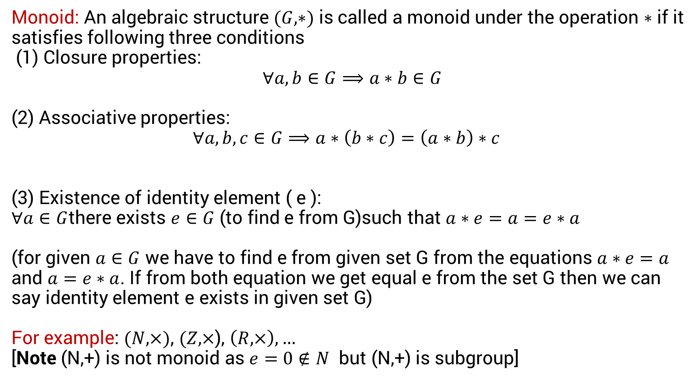
Monoid: An algebraic structure $(G,∗)$ is called a monoid under the operation $∗$ if it satisfies following three conditions (1) Closure properties: $$∀a,b∈G⟹a∗b∈G$$ (2) Associative properties: $∀a,b,c∈G⟹a∗\left(b∗c\right)=\left(a∗b\right)∗c$ (3) Existence of identity element ( e ): $∀a∈G$there exists $e∈G$ (to find e from G)such that $a∗e=a=e∗a$ (for given $a∈G$ we have to find e from given set G from the equations $a∗e=a$ and $a=e∗a$. If from both equation we get equal e from the set G then we can say identity element e exists in given set G) For example: $(N,×)$, $(Z,×$), $\left(R,×\right),…$ [Note (N,+) is not monoid as $e=0∉N$ but (N,+) is subgroup]

Slide 10
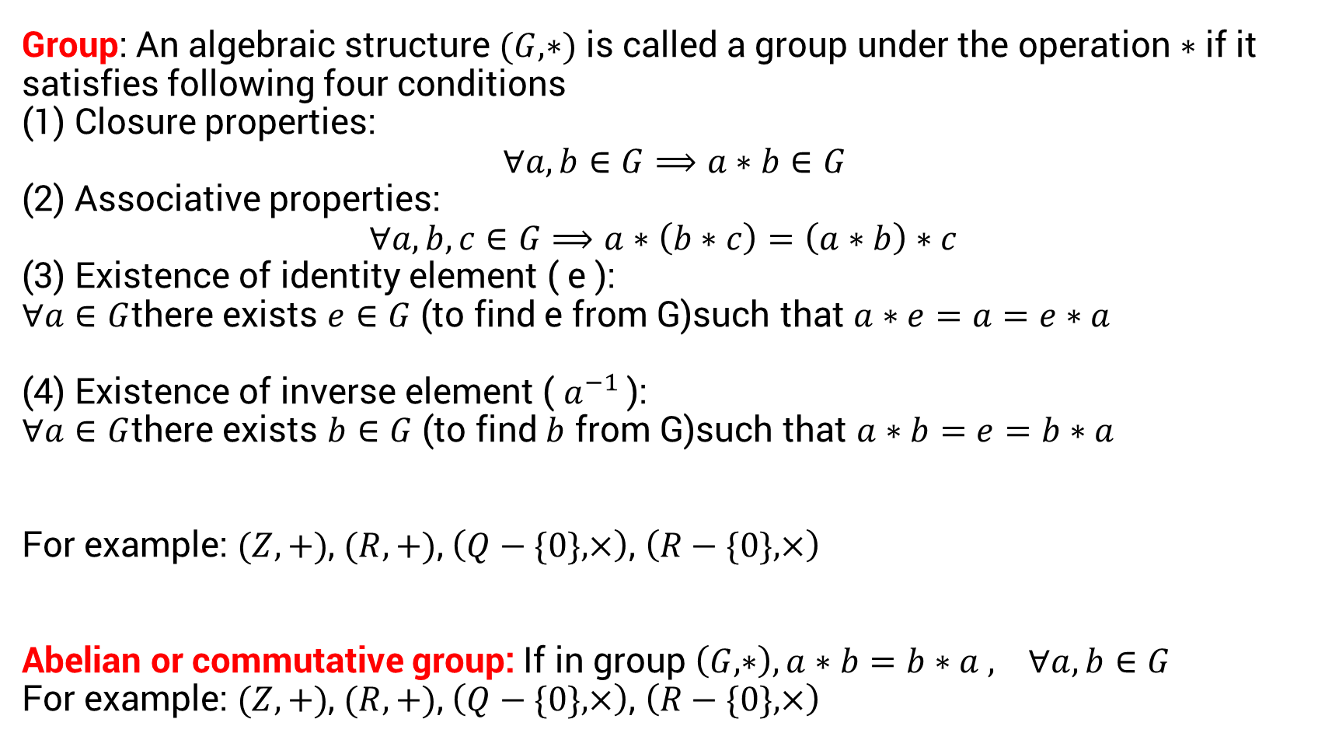
Group: An algebraic structure $(G,∗)$ is called a group under the operation $∗$ if it satisfies following four conditions (1) Closure properties: $$∀a,b∈G⟹a∗b∈G$$ (2) Associative properties: $∀a,b,c∈G⟹a∗\left(b∗c\right)=\left(a∗b\right)∗c$ (3) Existence of identity element ( e ): $∀a∈G$there exists $e∈G$ (to find e from G)such that $a∗e=a=e∗a$ (4) Existence of inverse element ( $a^{−1}$): $∀a∈G$there exists $b∈G$ (to find $b$ from G)such that $a∗b=e=b∗a$ For example: $(Z,+)$, $(R,+)$, $\left(Q−\{0\},×\right)$, $\left(R−\{0\},×\right)$ Abelian or commutative group: If in group $\left(G,∗\right), a∗b=b∗a , ∀a,b∈G$ For example: $(Z,+)$, $(R,+)$, $\left(Q−\{0\},×\right)$, $\left(R−\{0\},×\right)$

Slide 11
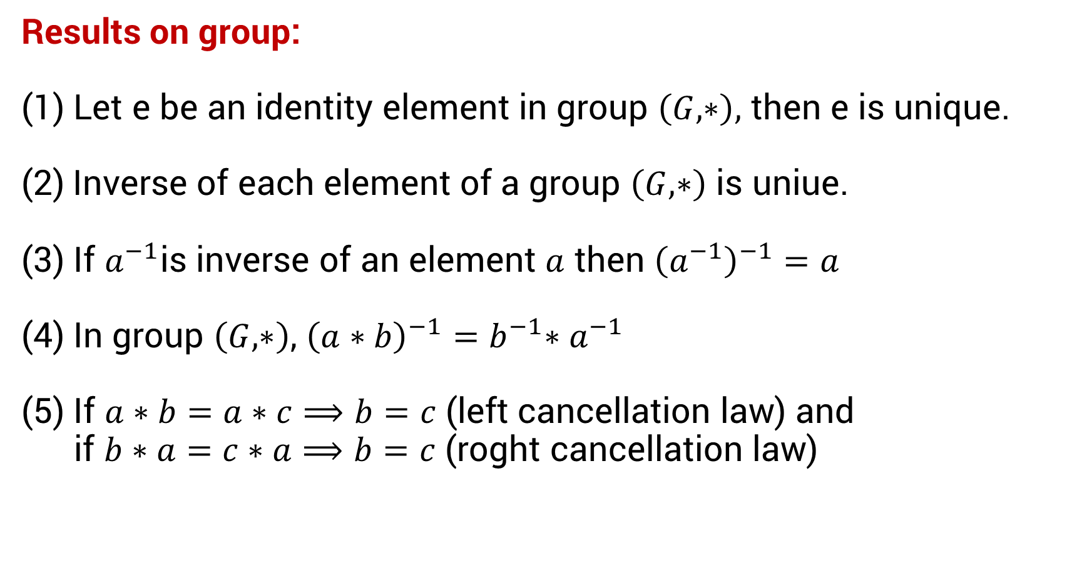
Results on group: (1) Let e be an identity element in group $\left(G,∗\right),$ then e is unique. (2) Inverse of each element of a group $\left(G,∗\right)$ is uniue. (3) If $a^{−1}$is inverse of an element $a$ then ${\left(a^{−1}\right)}^{−1}=a$ (4) In group $\left(G,∗\right)$, ${\left(a∗b\right)}^{−1}{=b}^{−1}∗a^{−1}$ (5) If $a∗b=a∗c⟹b=c$ (left cancellation law) and if $b∗a=c∗a⟹b=c$ (roght cancellation law)

